Slide 1
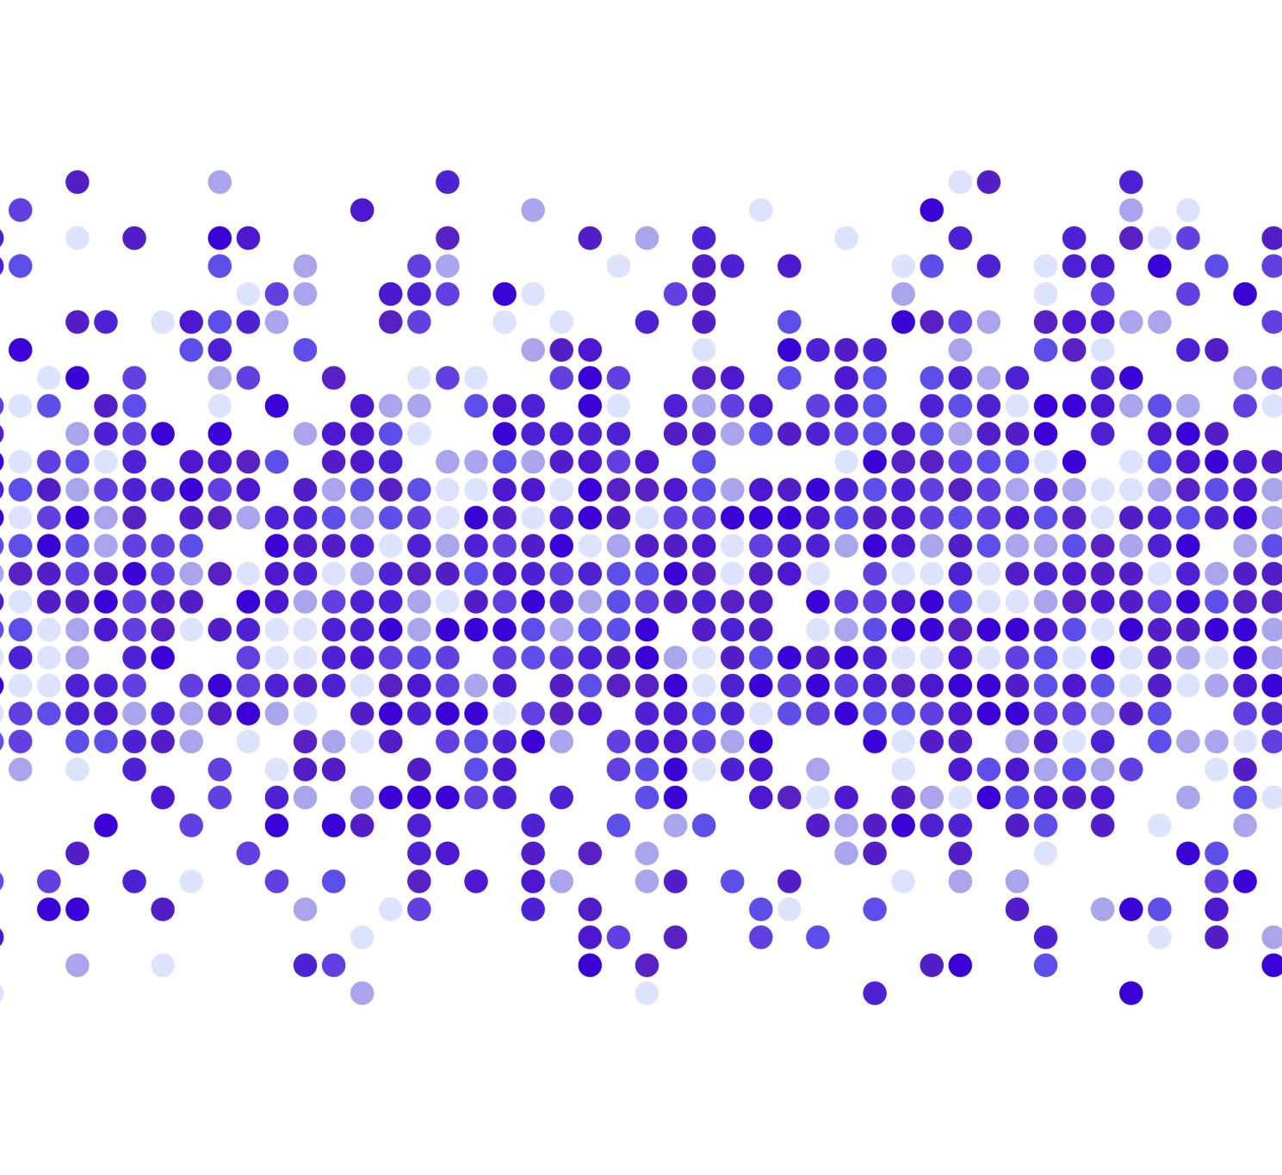
WhatsApp Chat Analysis for National Security
Group Members:
Bhavit Khandelwal : 15
Om Kakde : 54
Kartikey Dwivedi : 57
Vedant Khandekar : 59
Mandar Kulkarni : 65
Guided By:
Prof. Vaishali Jabade

Slide 2
Problem Statement
Presently the greatest source of misinformation and terrorist activity is through WhatsApp.
Our project aims at extracting information from WhatsApp chats and learn about the activities in a reported group by applying various algorithms
We propose this model to be implemented by cyber security in order to respect the privacy as well.

Slide 3
Importance
WhatsApp is the most used social media app by Indians because it provides free messaging and great voice and video calls.
Due to its popularity everyone uses WhatsApp but not always for good things.
Videos of celebrities drunk, traffic accidents, fights between people and other vulgar content are part of the large content archive that is spread through messages on WhatsApp.
We need this system now more than ever.

Slide 4

Libraries and Algorithms
Pytesseract
Numpy
Regex
Matplotlib
Wordcloud
Twilio
PyPDF2
Speech Recognition

Slide 5
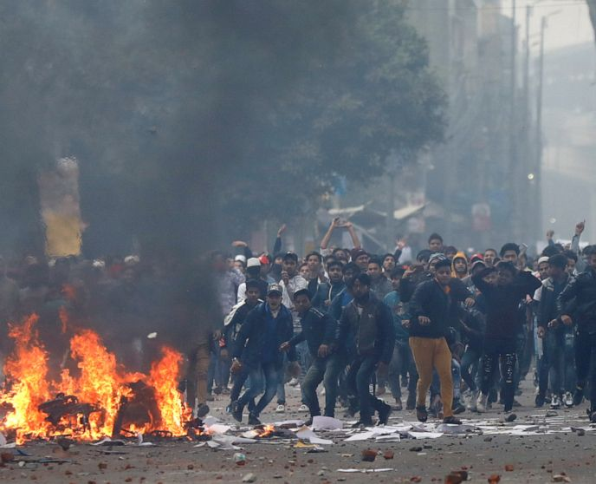
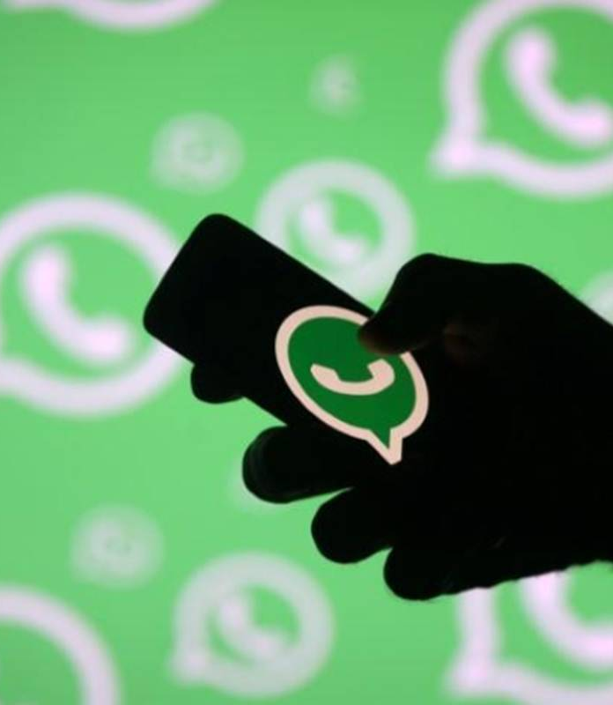
Our Approach
Our aim will be to keep an eye and record the harmful and violent WhatsApp messages that may lead to riots and even terrorist attack.
Project will also identify the images, videos and audio messages posted on WhatsApp.
If the level of such harmful messages crosses the margin, then we will report such WhatsApp groups to the Cyber security and other Security agencies.

Slide 6
Literature Survey
EDA analyses the data in statistical manner which includes measures of central tendency, measures of spread, the shape of the distribution and the existence of outliers.
A word cloud is a kind of a weighted list to visualize language or text data.
To Detect Violent Videos using Convolutional Long Short-Term Memory.
Recursive methodology for radical communities' detection on social networks.
Data mining (DM) deals with preparation of data obtained from various information sources as well as data modeling using a variety of techniques, depending on the goal that one wants to achieve.

Slide 7
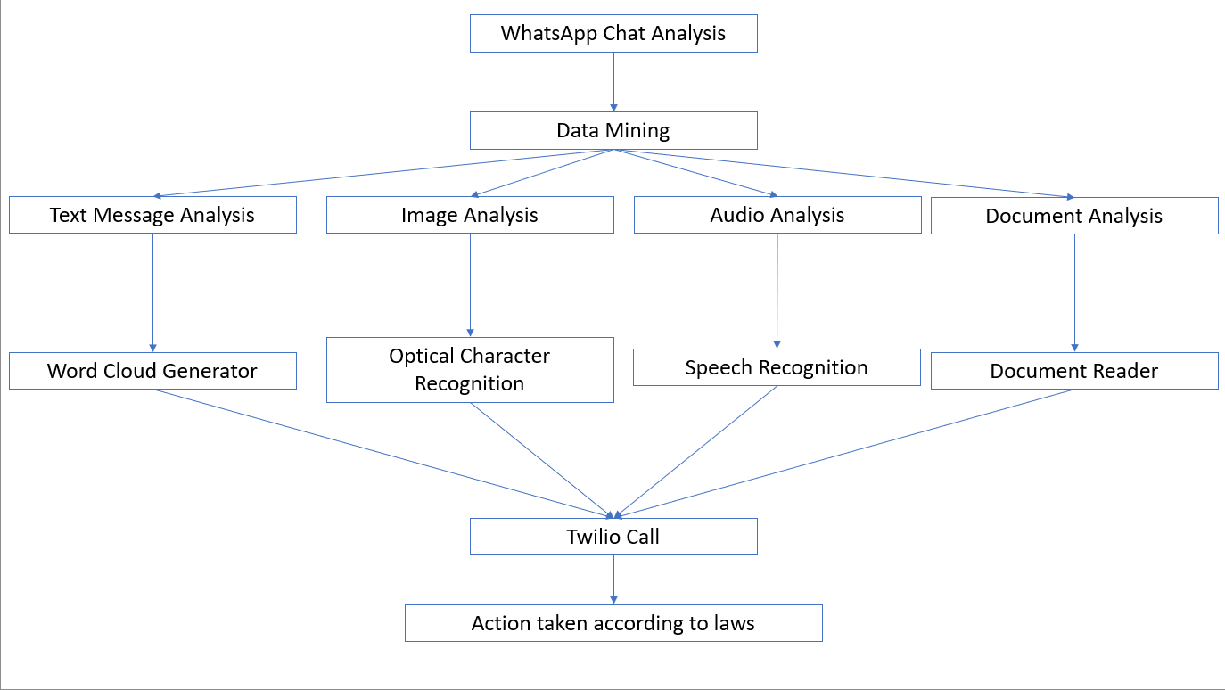
Flowchart

Slide 8
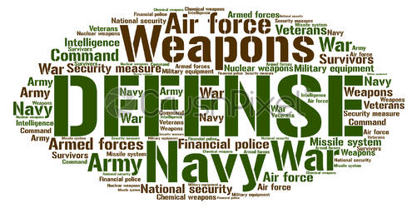
Development of WordCloud Generator
A wordcloud is a kind of weighted list to visualize language or text data
Font size indicated by :
•Frequency – number of keywords
•Categorization – number of subcategories
•Mixed - In the mixed type, the data contains both frequency and categorization
How a Wordcloud is made ?

Slide 9
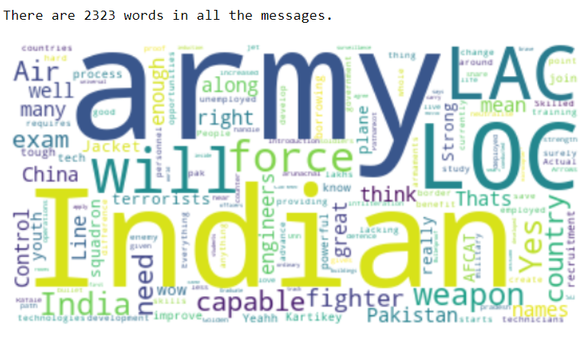
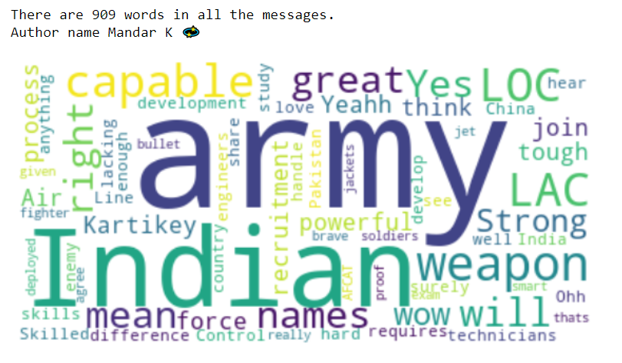
Results :
Generalized wordcloud
Author specific wordcloud

Slide 10
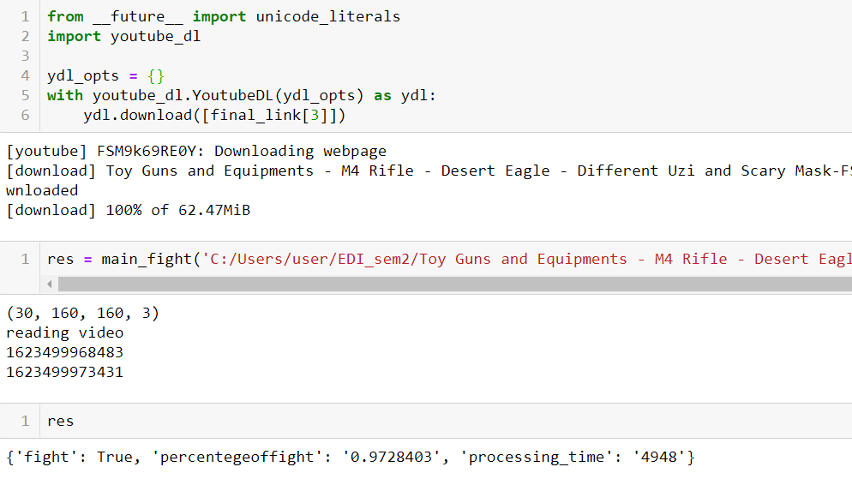
YouTube Link scanning
Thousands of links are shared on What's app daily , most of them might be useful but some contain malicious content which can provoke a certain group of people . So detecting violence in a video is very important .

Slide 11
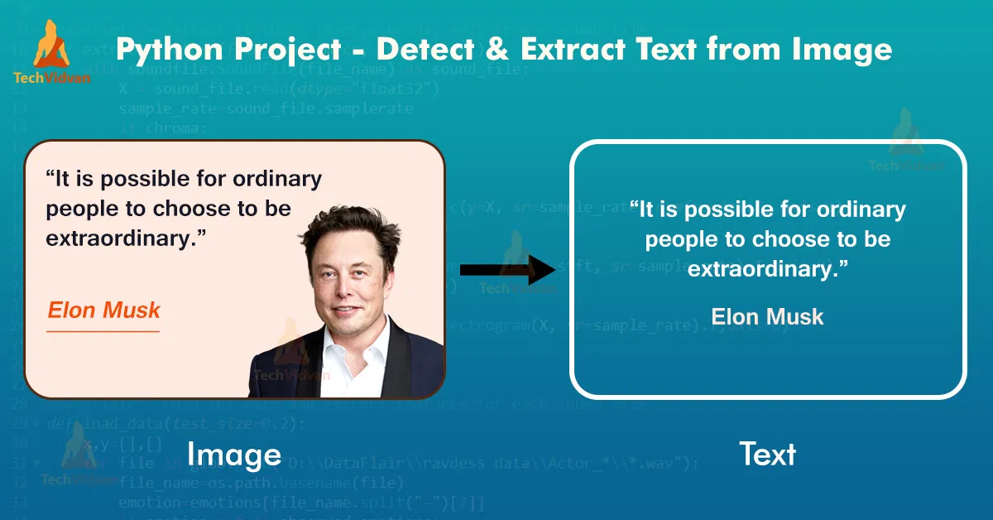
Image Text Extraction
OCR (Optical Character Recognition) is the process of electronical conversion of Digital images into machine-encoded text. Where the digital image is generally an image that contains regions that resemble characters of a language

Slide 12
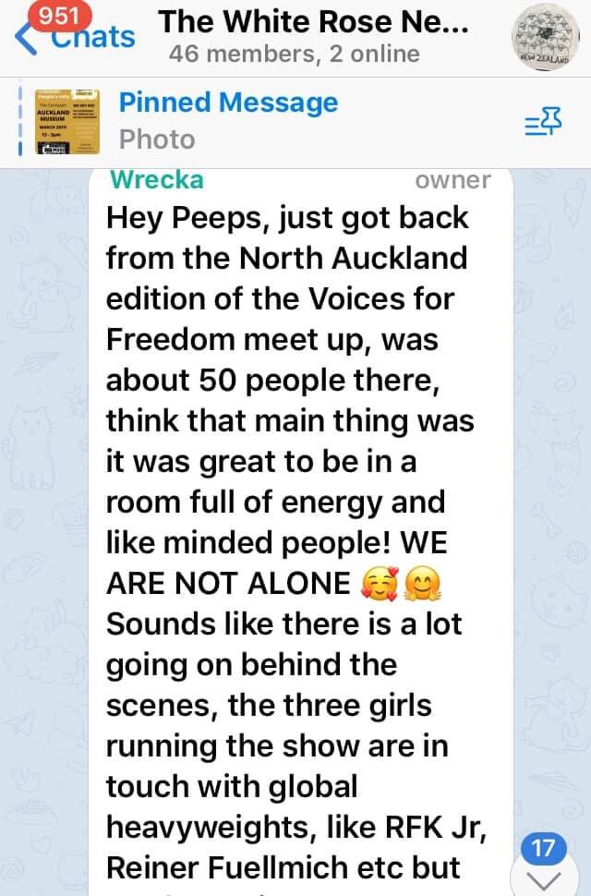
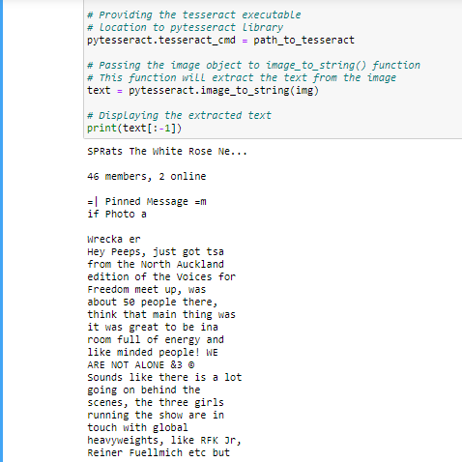

Slide 13
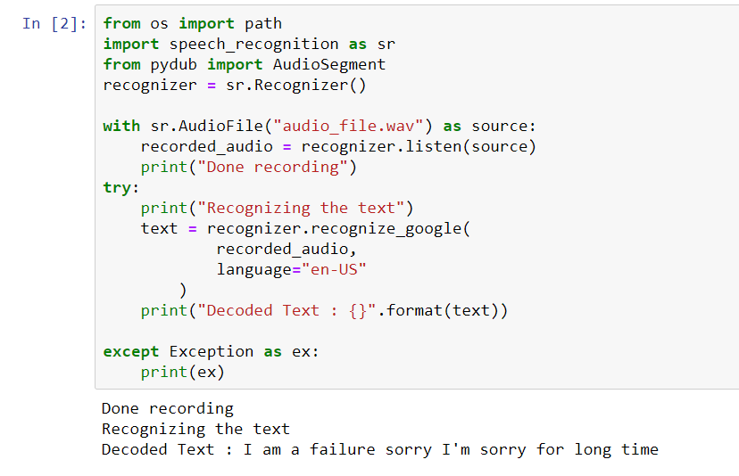
Audio Checkup
Audio messages or recordings is another way to communicate on WhatsApp.
It is also important to monitor the audio files.
Libraries used: Speech Recognition & Pydub.

Slide 14
Document Analysis
Document Analysis plays a very crucial role in this project as documents are one of the most shared data type on WhatsApp.
Documents hold valuable information like addresses, bills, catalogues, magazines, and scanned images.
To mine data from a document we have used a python library called PyPDF. This library reads all the text present in a document and creates a temporary text file.
At the end of the process compiles all the information on it and displays the contents.

Slide 15
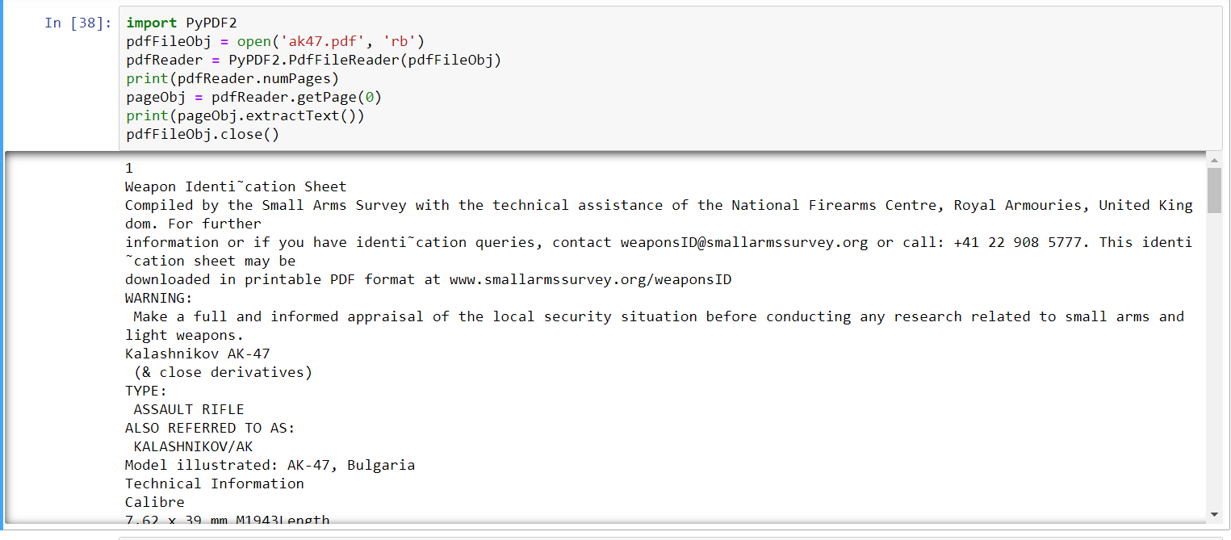
Result

Slide 16

CALLING FEATURE:
If malicious activities are found to be high enough, a call will be placed to the registered cyber agency number (for now we have registered our own numbers for the call)
In order to place calls successfully, Twilio python package has been used.

Slide 17
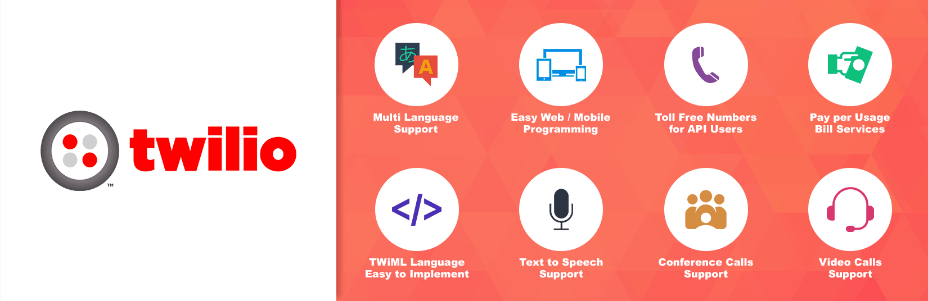
What is Twilio?
Twilio is a cloud communication company that enables users to use standard web languages to build voice, VoIP, and SMS apps via a web API.

Slide 18
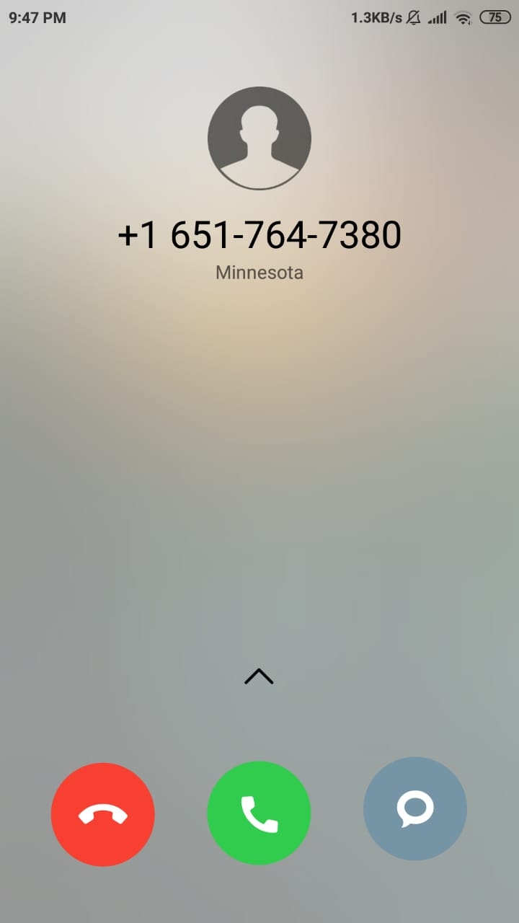
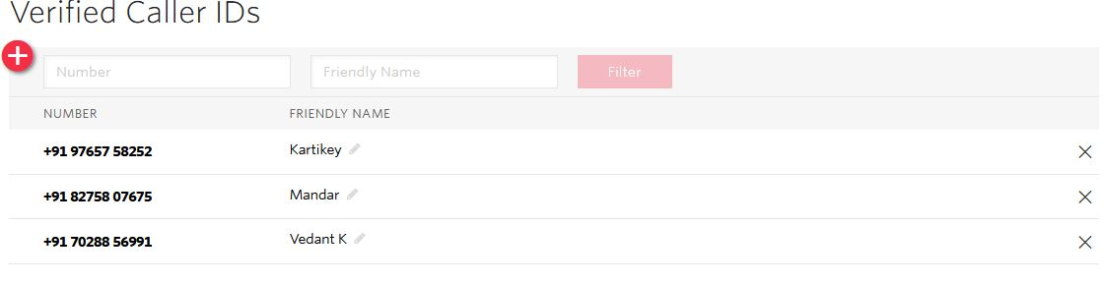
Twilio Results

Slide 19
Advantages
1-WhatsApp Chat Analyzer can help in tracking the terrorist groups by intercepting their messages.
2-This project can help in detecting the violent communities present in India.
3-This can help police in stopping the planned riot and clashes between any communities.
4-This project also has feature in which automatically one warning call is sent to the user if he is involved in sending the negative words chats or any images regularly.
Disadvantages
1-There is major issue of privacy.
2-Data breaching can happen, and that data can be used for any harmful activities.

Slide 20
References
[1] Kabita Sahoo, Abhaya Kumar Samal, Jitendra Pramanik, Subhendu Kumar Pani , “Exploratory Data Analysis using Python”, International Journal of Innovative Technology and Exploring Engineering (IJITEE)ISSN: 2278-3075,Volume-8, Issue-12,October 2019
[2] Jin, Y. (2017). Development of Word Cloud Generator Software Based on Python. Procedia Engineering, 174, 788–792. doi:10.1016/j.proeng.2017.01.223
[3] Sudhakaran, S., & Lanz, O. (2017). Learning to detect violent videos using convolutional long short-term memory. 2017 14th IEEE International Conference on Advanced Video and Signal Based Surveillance (AVSS). doi:10.1109/avss.2017.8078468
[4] Amal Rekik, Salma Jamoussia, Abdelmajid Ben Hamadoua, A recursive methodology for radical communities’ detection on social networks, 24th International Conference on Knowledge-Based and Intelligent Information & Engineering Systems
[5] Stancin, I., & Jovic, A. (2019). An overview and comparison of free Python libraries for data mining and big data analysis. 2019 42nd International Convention on Information and Communication Technology, Electronics and Microelectronics (MIPRO). doi:10.23919/mipro.2019.8757088.

Slide 21
Thank You!

